Slide 1

SECURITY oN MOBILE DEVICES Vitaly Shmatikov

Slide 2
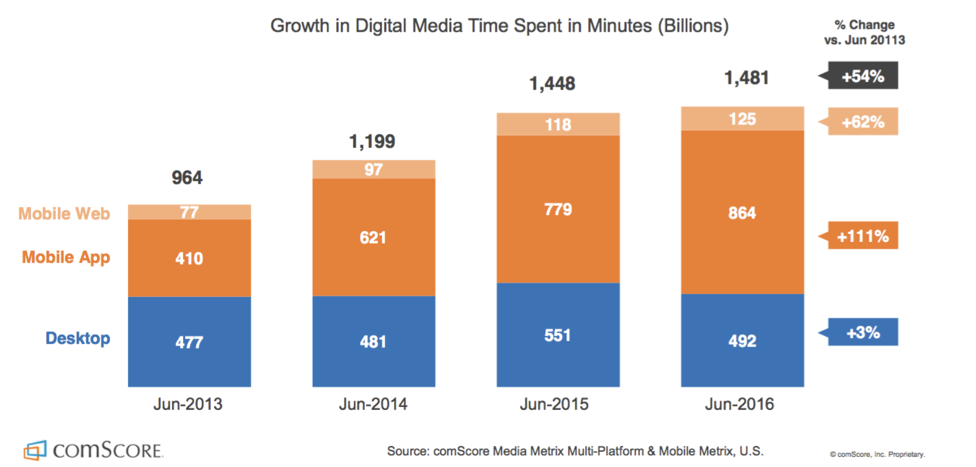
Where Users Spend Time

Slide 3


What’s Valuable on Phones?
Identify location
Record phone calls
Log SMS (remember 2FA SMS?)
Send premium SMS messages
Steal contact list, email, messaging, banking/financial information, private photos…
Phishing
Malvertising
Join Bots
specific to mobile

Slide 4
Physical Threats
Powered-off devices under complete physical control of an adversary
Including well-resourced nation-states, police, etc.
Screen-locked devices under physical control of an adversary (e.g. thieves)
Unlocked devices under control of different user (e.g. intimate partner abuse)
Devices in physical proximity to an adversary who control radio channels, including cellular, WiFi, Bluetooth, GPS, NFC

Slide 5
Untrusted Code
Mobile OSes intentionally allow (with explicit user consent) installation of application code from arbitrary sources that can…
Abuse APIs supported by the OS with malicious intent, e.g. spyware
Exploit bugs in the OS
Mimic system or other app user interfaces to confuse users
Read content from system or other application user interfaces (e.g., screen-scrape)
Inject input events into system or other app user interfaces

Slide 6
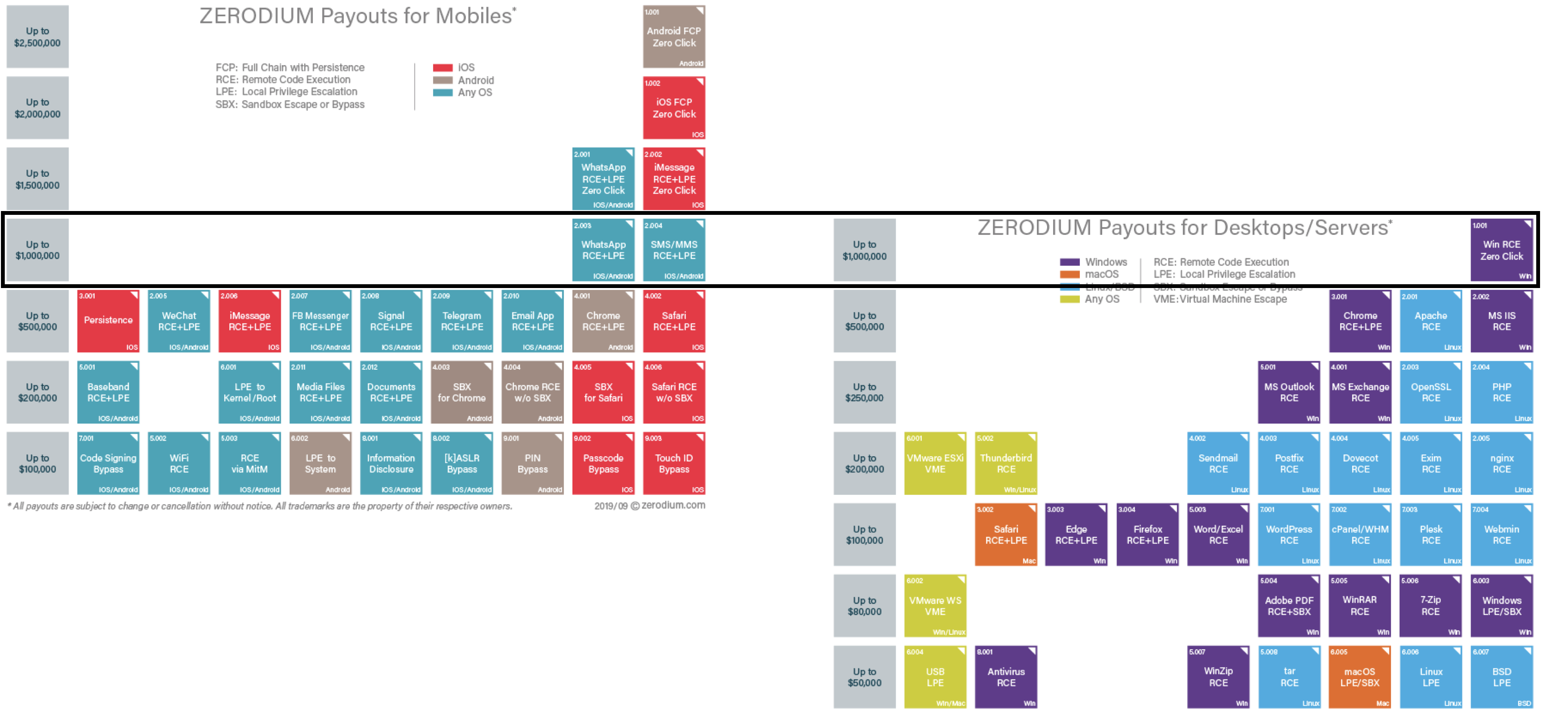
Mobile Exploits Very Valuable

Slide 7
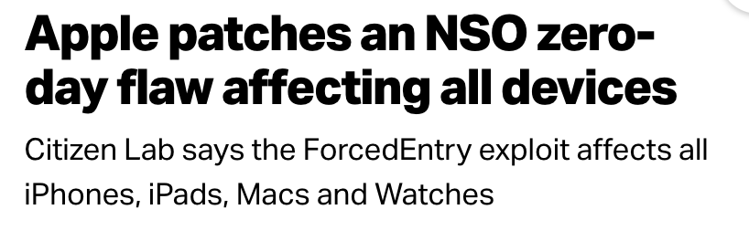
Remember the emergency Apple update on September 13, 2021?
The flaw in iMessage was exploited by the Pegasus spyware from Israeli firm NSO group to gain full access to victims’ devices.
The exploit broke through new iPhone defenses that Apple had baked into iOS 14, dubbed BlastDoor, which were supposed to prevent silent attacks by filtering potentially malicious code.
NSO is infamous for developing, weaponizing, and deploying zero-click exploits against messaging apps
Based on an integer overflow vulnerability in CoreGraphics image rendering library.
https://techcrunch.com/2021/09/13/apple-zero-day-nso-pegasus/

Slide 8
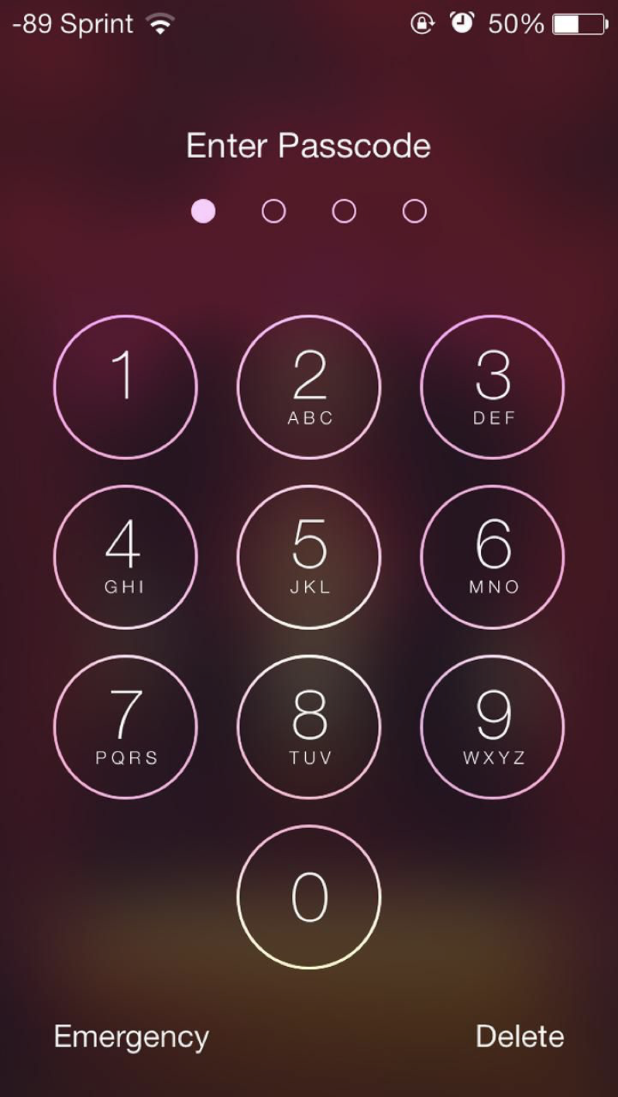
Unlocking Device
PINs,
patterns,
alphanumeric passwords
…

Slide 9
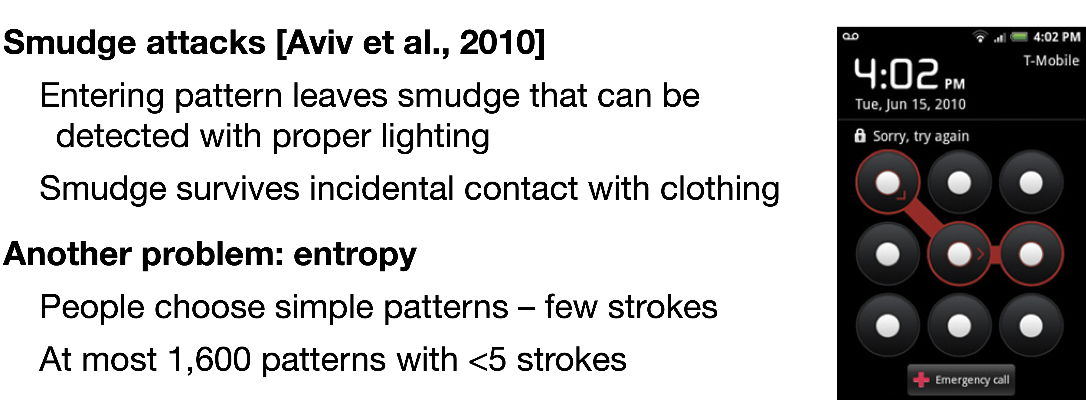
Swipe Code Problems

Slide 10
iPhone Password Hashing
Goal: password hashing where a 4-8 digit PIN takes a very long time to crack, even if the device is physically compromised
Phone-specific aspects:
Lots of computation uses up battery
Physical access allows copying secret off the device and cracking remotely

Slide 11
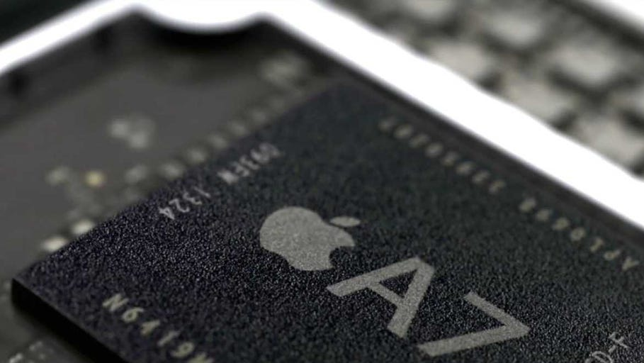
Secure Enclave
Additional secure processor inside every iPhone
Memory inaccessible to normal OS
Utilizes a secure boot process that ensures its software is signed
AES key burned in at manufacture
Secure enclave has instructions that allow encrypting and decrypting content using the key, but the key itself is never accessible (incl. via JTAG)

Slide 12
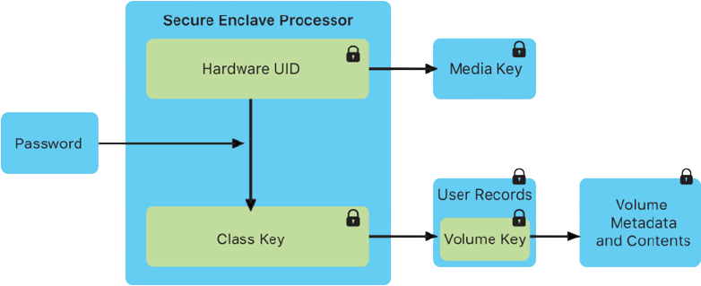

iPhone Unlocking
The passcode is entangled with the device’s UID many times: Encrypt_{UID}(Encrypt_{UID}(Encrypt_{UID}(passcode)…))
User passcode is entangled with the AES key fused into secure enclave (known as UID)
The key to decrypt the device can only be derived on the single secure enclave on a specific phone -- not possible to take offline and brute force
Approx. 80ms per password check
5 failed attempts ⇒ 1 min delay
9 failures ⇒ 1 hour delay
10 failed attempts ⇒ erase phone
enforced by firmware on the secure enclave itself — cannot be changed by iOS

Slide 13
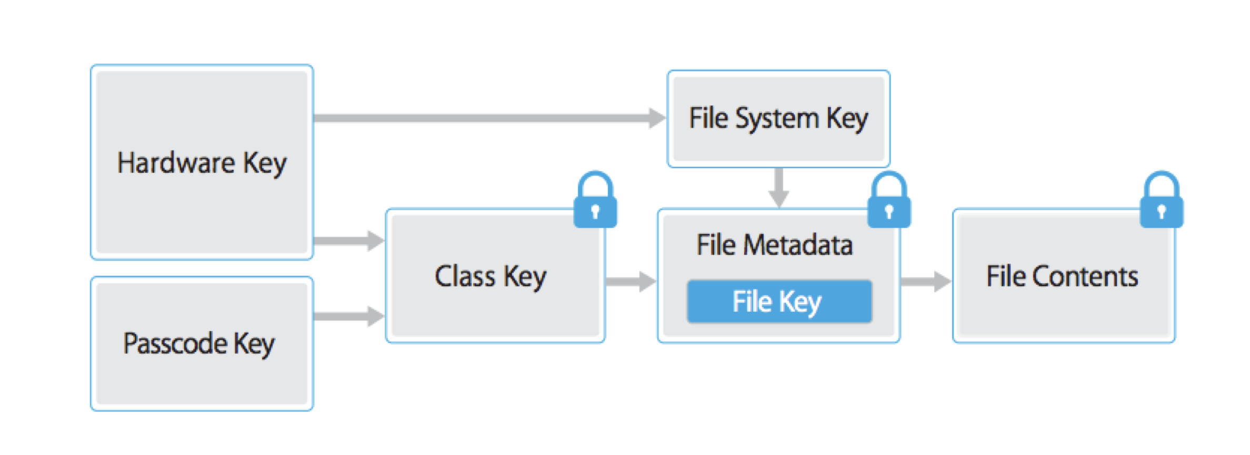
FaceID / TouchID
Application files written to flash memory
are encrypted through a hierarchy of keys:
Per-file key: encrypts all file contents (AES-XTS)
Class key: encrypts per-file key (ciphertext stored in metadata)
File-system key: encrypts file metadata
By default (no FaceID, TouchID), class encryption keys are erased from memory of secure enclave whenever the device is locked or powered off
When TouchID/FaceID is enabled, class keys are kept and hardware sensor sends fingerprint image to secure enclave. All ML/analysis is performed within the secure enclave.

Slide 14
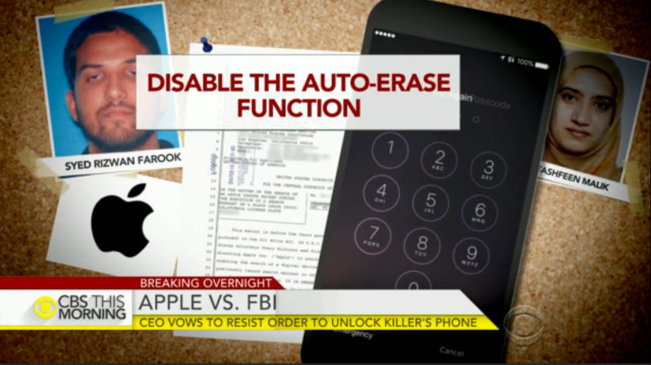
Apple-FBI Dispute
2016: FBI attempted to compel Apple to unlock San Bernardino killer’s phone

Slide 15
Technical Details of the Apple-FBI Dispute
The court order wanted a custom version of the secure enclave firmware that would…
1."it will bypass or disable the auto-erase function whether or not it has been enabled"
2."it will enable the FBI to submit passcodes to the SUBJECT DEVICE for testing electronically via the physical device port, Bluetooth, Wi-Fi, or other protocol"
3."it will ensure that when the FBI submits passcodes to the SUBJECT DEVICE, software running on the device will not purposefully introduce any additional delay between passcode attempts beyond what is incurred by Apple hardware”
this user-configurable feature of iOS 8 automatically deletes keys needed to read encrypted data after ten consecutive incorrect attempts

Slide 16
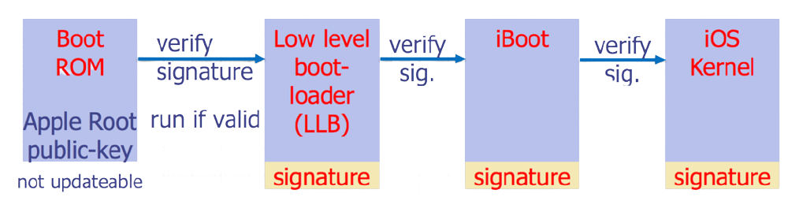
Why Couldn’t FBI Upload Their Own Firmware?
Secure boot chain
When an iOS device is turned on, it executes code from read-only memory known as Boot ROM. This immutable code, known as the hardware root of trust, is laid down during chip fabrication, and is implicitly trusted.
The Boot ROM code contains the Apple Root CA public key, which is used to verify that the bootloader is signed by Apple. This is the first step in the chain of trust where each step ensures that the next is signed by Apple.

Slide 17
Secure Software Updates
To prevent devices from being downgraded to older versions that lack the security updates, iOS uses System Software Authorization
Device connects to Apple with cryptographic descriptors of each component update (e.g., boot loader, kernel, and OS image), current versions, a random nonce, and device-specific Exclusive Chip ID (ECID)
Apple signs device-personalized message allowing update, which boot loader verifies, both for main processor and secure enclave

Slide 18
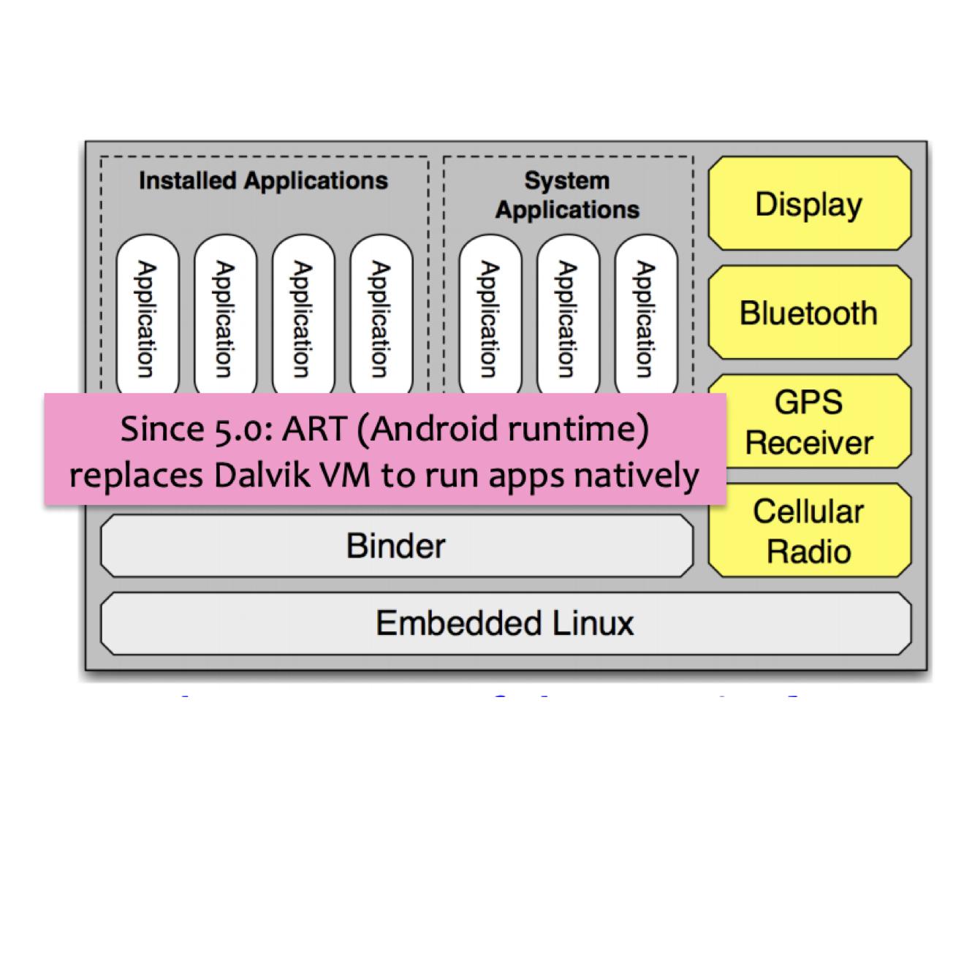
Android Isolation
Based on SE Linux (Linux with sandboxes)
Applications run as separate user IDs, in separate processes
Attacks compromise the application, but not the entire system
To escape sandbox, must compromise Linux kernel

Slide 19
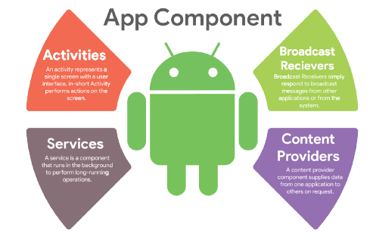
Structure of Android Applications
Messages from other apps
Intents are primary messaging mechanism for interaction between components
User interface
Background processing
Data storage
Image source: https://medium.com/@Abderraouf/understand-android-basics-part-1-application-activity-and-lifecycle-b559bb1e40e

Slide 20
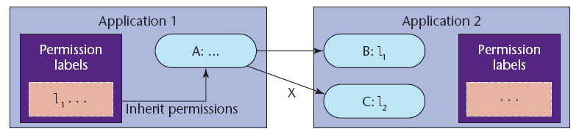
Android Security Model
Based on permission labels assigned to applications and components
Every app runs as a separate user
Underlying Unix OS provides system-level isolation
Android middleware mediates inter-component communication
Access permitted if labels assigned to the invoked component are in the collection of invoking component

Slide 21
Mandatory Access Control
Permission labels are set (via manifest) when app is installed and cannot be changed
Permission labels only restrict access to components, they do not control information flow
Apps may contain “private” components that should never be accessed by another app (example?)
If a public component doesn’t have explicit permissions listed, it can be accessed by any app
Means what?

Slide 22
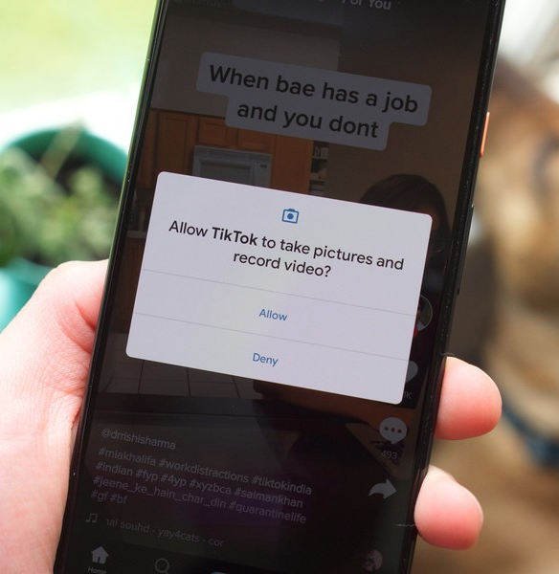
System API Access
System functionality (eg, camera, networking) is accessed via Android API, not system components
App must declare the corresponding permission label in its manifest + user must approve at the time of app installation
Signature permissions are used to restrict access only to certain developers
Example: Only Google apps can directly use telephony API

Slide 23
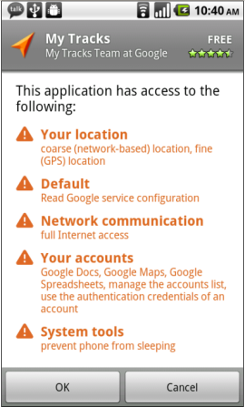
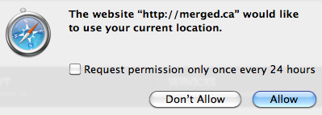
Permissions: Not Just Android
All mobile OSes, HTML5 apps, browser extensions…

Slide 24

Explicit Intents
Name: MapActivity
Map
App
Yelp
To: MapActivity
Only the specified destination receives this message

Slide 25
Implicit Intents
Handles Action: VIEW
Map
App
Handles Action: VIEW
Yelp
Browser
App
Implicit Intent
Action: VIEW

Slide 26
Access Control for Intents
Permission labels on broadcast intents
Prevents unauthorized apps from receiving these intents – why is this important?
Pending intents: Instead of directly performing an action via intent, create an object that can be passed to another app, thus enabling it to execute the action
Invocation involves RPC to the original app
Introduces delegation into Android’s MAC system

Slide 27


Permission Re-Delegation
An application with a permission performs a privileged task on behalf of an application without permission
User pressed button
pressButton(0)
Malware
Settings
app
Malware
Settings
app
TurnOnWifi()
turnOnWifi()
Public service
for receiving
UI messages
turnOnWifi()
Permission System
Permission System
API
API
Felt et al. “Permission Re-Delegation: Attacks and Defenses” (2011)

Slide 28
Re-Delegation is a Confused Deputy Problem
The “deputy” app may accidentally expose privileged functionality…
… or intentionally expose it, but the attacker invokes it in a surprising context
Example: broadcast receivers in Android
… or intentionally expose it and attempt to reduce the invoker’s authority, but do it incorrectly
Remember URL checks on webhooks?
Parent frame origin checks in frame-busting code?

